Slide 1
MINI PROJECT

Slide 2
TEXT EDITOR WITH PASSWORD SECURITY

Slide 3
PROJECT DONE BY
Dinesh Kumar D
Sanjay Kumar B
Viknesh K T
- With the guidance : Dr.M.Poongothai
Assistant Professor(SR), Dept. Of IT, GCE(IRTT)

Slide 4
PROGRAMMING LANGUAGES USED
Back End:
Python
PHP
MySQL
Front End:
HTML/CSS
Title: Text Editor with Password Security Done by: Dinesh Kumar D Sanjay Kumar B Viknesh K T

Slide 5
TOOLS USED
- Visual Studio Code
- XAMPP / MySQL Workbench
Title: Text Editor with Password Security Done by: Dinesh Kumar D Sanjay Kumar B Viknesh K T

Slide 6
ABSTRACT
The motive of the project is that to make a user to create notes online and it can be stored in the database with the help of user registration. The user need to register first and then to create notes the user need to login. Once user successfully registered he can able to create notes, edit notes and update it, delete notes. The password of the user is encrypted while registering so no one can know the password of the other users. By this the project provides security to the users. Unique users can’t able to create multiple notes with the same note title so, the problem on collapsing is avoided. User can able to create notes with simple internet connection. The email_id is their user_id and the Primary key. The user datas are stored in table format in the database. The user interface is user friendly so, the end user can also be able to create notes in a easy manner.
Title: Text Editor with Password Security Done by: Dinesh Kumar D Sanjay Kumar B Viknesh K T

Slide 7
WHY THIS PROJECT?
By using this project user can save their notes in online(database)
Notes created by users can only viewed by them
No unauthorized person(hackers) can view other users notes
It is achieved by using RSA algorithm
Title: Text Editor with Password Security Done by: Dinesh Kumar D Sanjay Kumar B Viknesh K T

Slide 8
PROGRAM DESCRIPTION
In this project we have used the programming languages like Python, MySQL and PHP.
We have created a Web page for user to Register and Login.
Once a user successfully registered he is free to create his notes on the website.
The user password is encrypted with RSA, so no one can able to view the password.
We have connected all the files(Local files and Database) using PHP and MySQL.
Title: Text Editor with Password Security Done by: Dinesh Kumar D Sanjay Kumar B Viknesh K T

Slide 9
RSA ALGORITHM FOR SECURITY
RSA – Rivest Shamir Adleman
It uses public key for encryption of the data
Private key is used for decrypting the data
Passwords stored in the database are hided for unauthorized users(like hackers)
Only respective user can view the data
Title: Text Editor with Password Security Done by: Dinesh Kumar D Sanjay Kumar B Viknesh K T

Slide 10
STEPS FOR ENCRYPTION AND DECRYPTION
Generate two random prime number:
P = 23; Q = 1117
N = 23 * 1117 = 25691
Totient variable pi(n) = (p-1)*(q-1)
Public key e --> 1<e<pi(n)
GCD (e, pi(n)) = 1 --> Relatively prime
Private key d = e inverse of mod pi(n)
Title: Text Editor with Password Security Done by: Dinesh Kumar D Sanjay Kumar B Viknesh K T

Slide 11
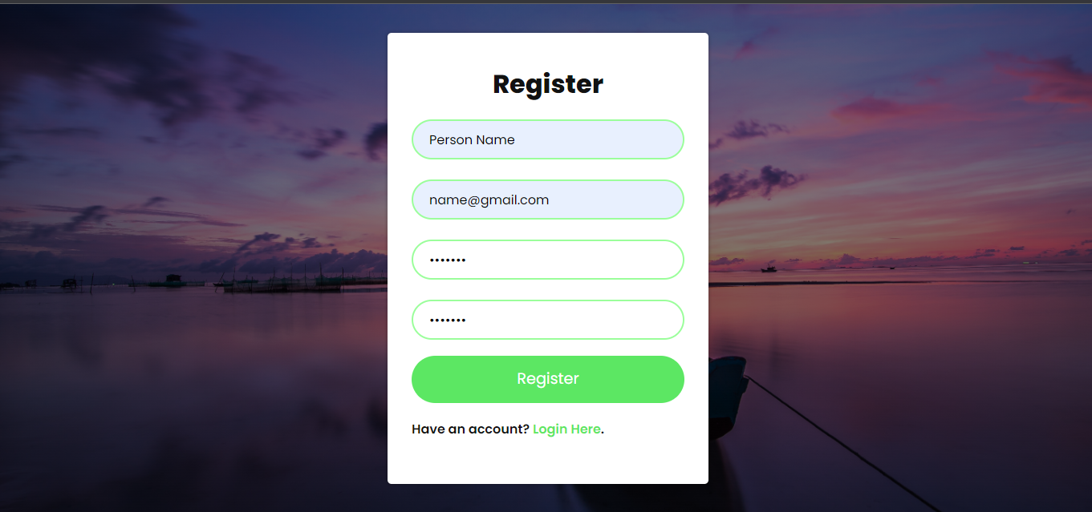
LOOK UP OF THE PROJECT
Title: Text Editor with Password Security Done by: Dinesh Kumar D Sanjay Kumar B Viknesh K T

Slide 12
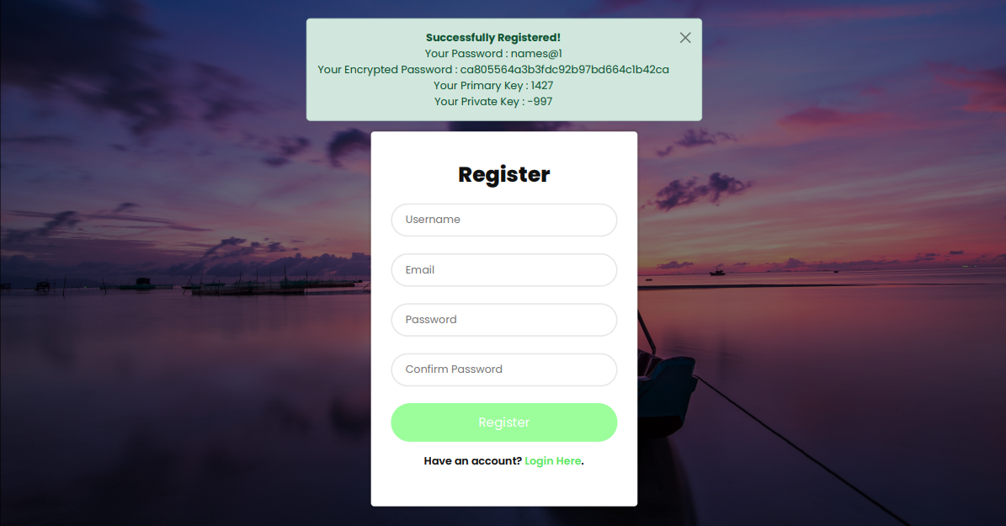
Title: Text Editor with Password Security Done by: Dinesh Kumar D Sanjay Kumar B Viknesh K T

Slide 13
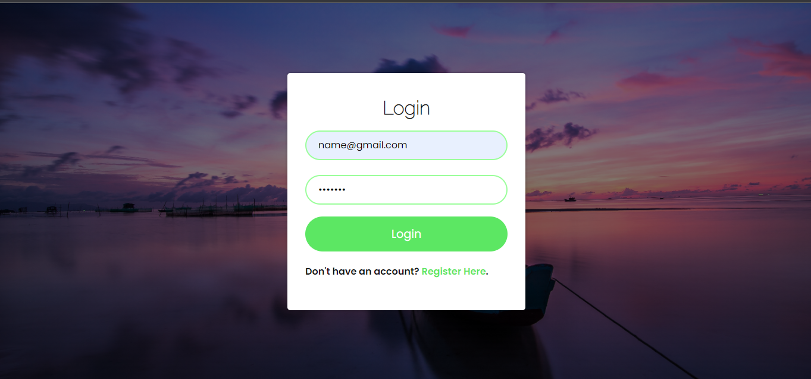
Title: Text Editor with Password Security Done by: Dinesh Kumar D Sanjay Kumar B Viknesh K T

Slide 14
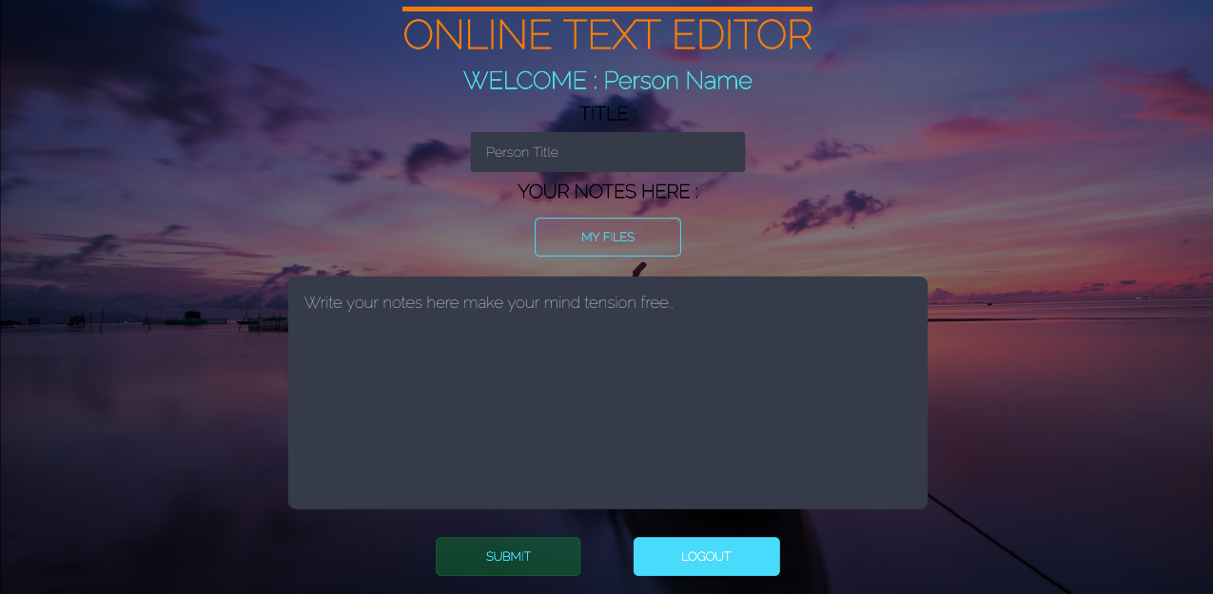
Title: Text Editor with Password Security Done by: Dinesh Kumar D Sanjay Kumar B Viknesh K T

Slide 15
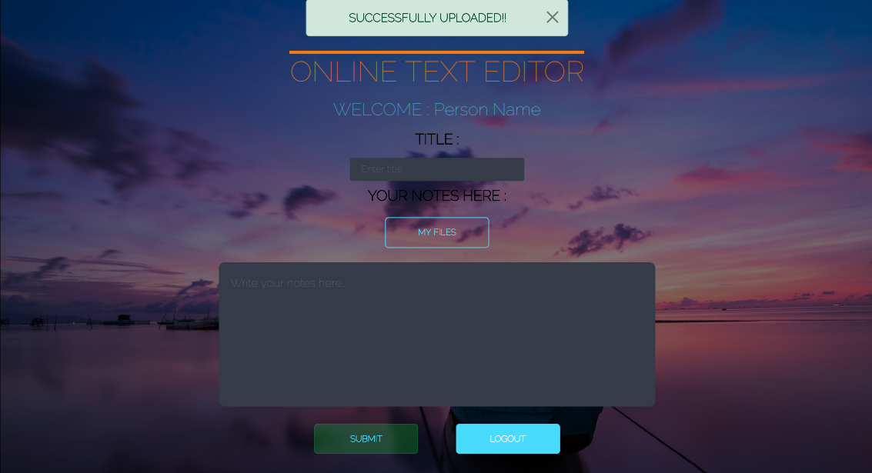
Title: Text Editor with Password Security Done by: Dinesh Kumar D Sanjay Kumar B Viknesh K T

Slide 16
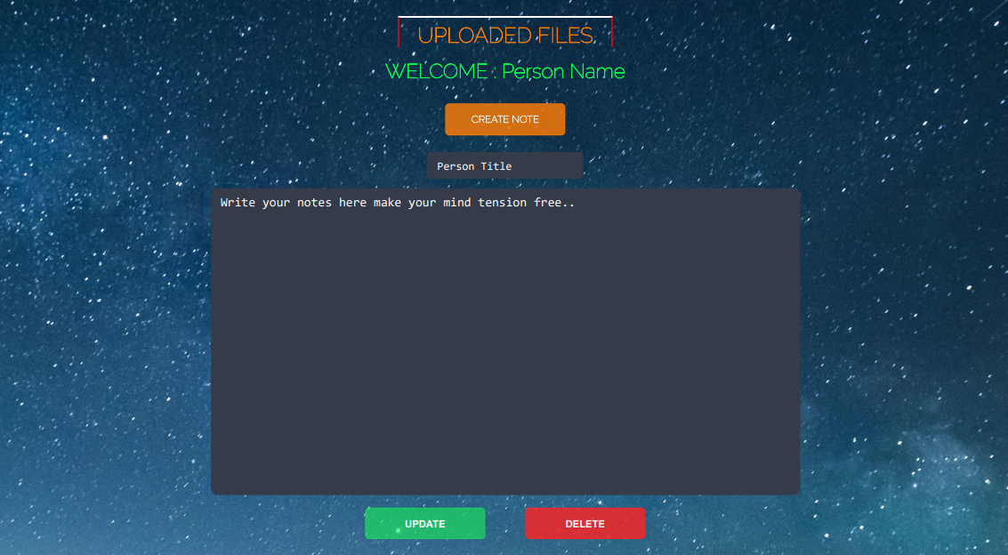
Title: Text Editor with Password Security Done by: Dinesh Kumar D Sanjay Kumar B Viknesh K T

Slide 17
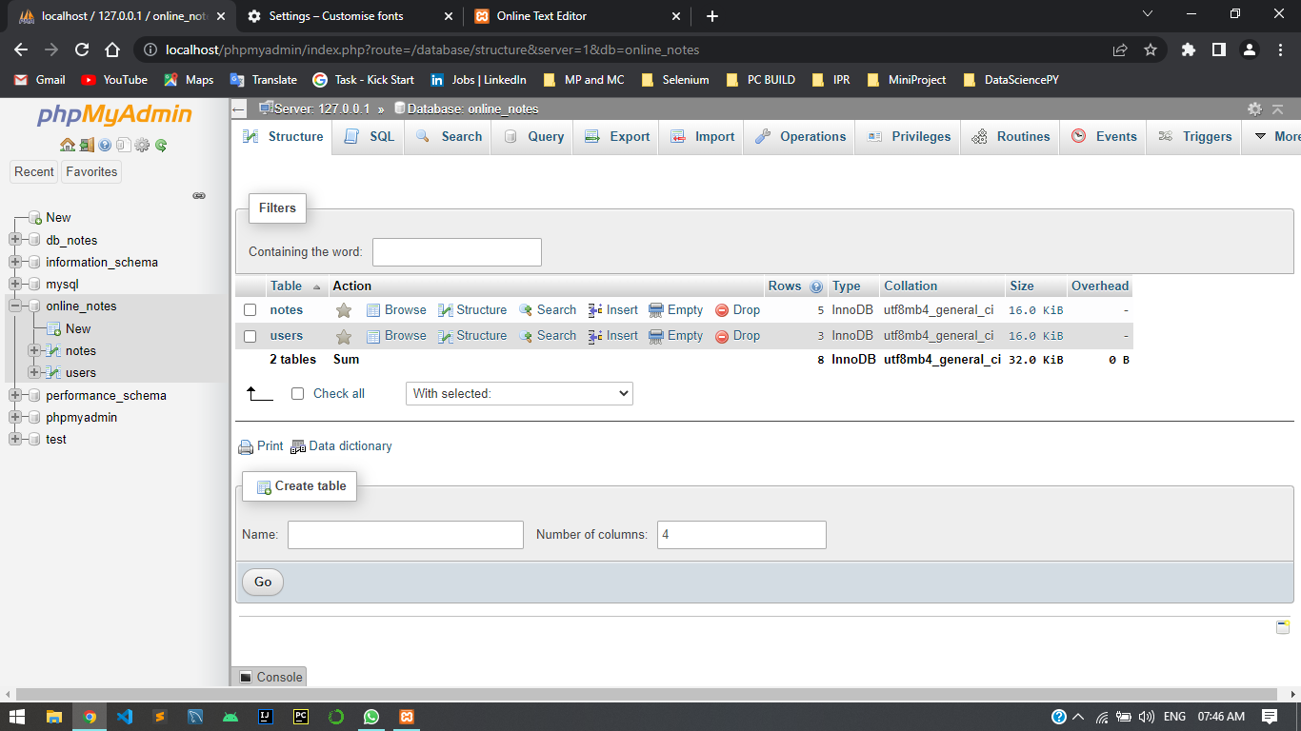
Title: Text Editor with Password Security Done by: Dinesh Kumar D Sanjay Kumar B Viknesh K T

Slide 18
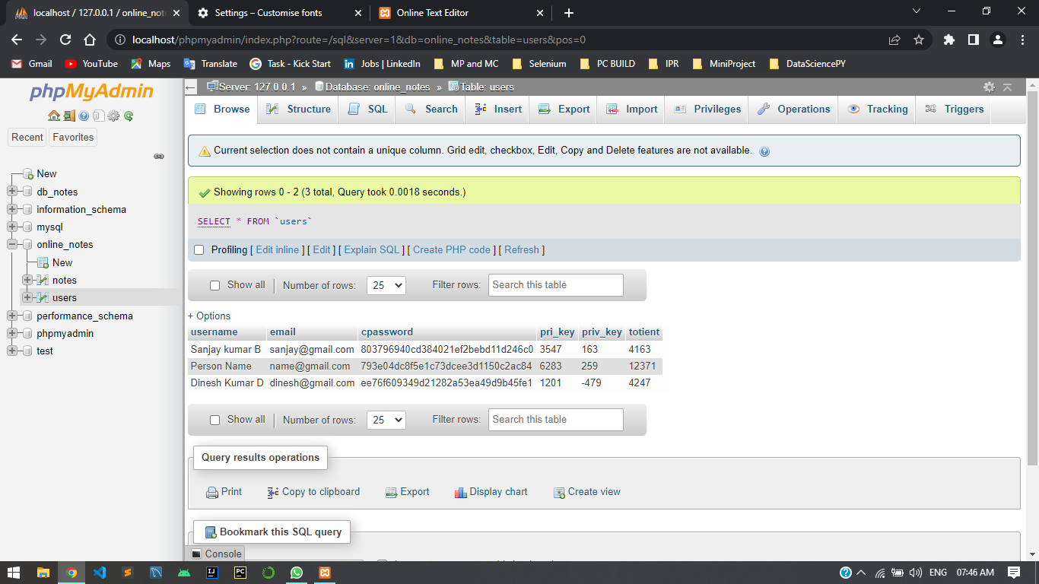
Title: Text Editor with Password Security Done by: Dinesh Kumar D Sanjay Kumar B Viknesh K T

Slide 19
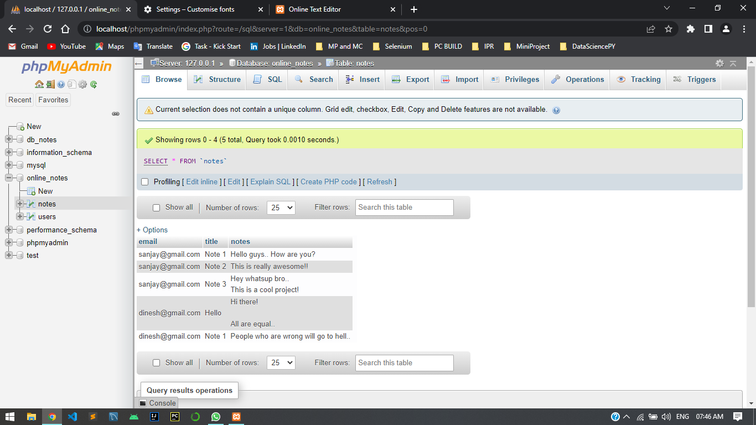
Title: Text Editor with Password Security Done by: Dinesh Kumar D Sanjay Kumar B Viknesh K T

Slide 20
REFERENCE
BOOTSTRAP - https://getbootstrap.com/
W3SCHOOLS - https://www.w3schools.com/

Slide 21
THANK YOU

